Slide 1
Transistor-Level Timing Analysis and Optimization of USB TX FIFO and UART TX Controller
BY GROUP-3
2310040032-M. Sravya
2310040077-T.Tejaswini

Slide 2
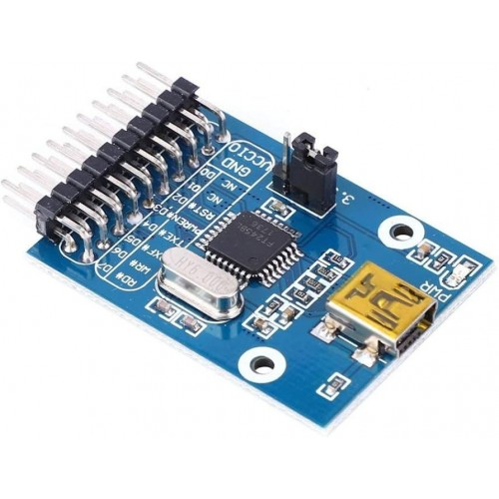
OBJECTIVES
To design a transistor-level USB TX FIFO using CMOS D flip-flops.
To implement a UART TX controller using shift-register based architecture.
To perform transistor-level timing analysis including setup time, hold time, and clock-to-Q delay.
To identify critical timing paths between FIFO and UART TX stages.
To introduce timing violations and analyze their impact on data transmission.
To optimize the design using transistor sizing and buffering techniques.
To improve timing margins and ensure reliable transmit-side operation.

Slide 3
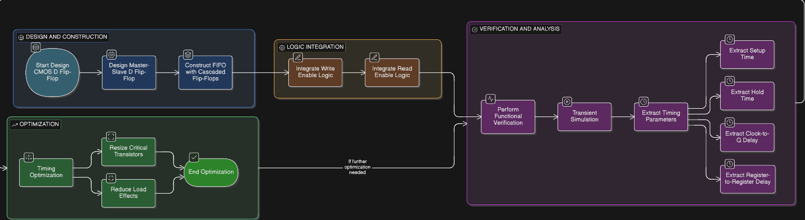
METHODOLOGY
Design of CMOS master–slave D flip-flops as FIFO storage elements.
Construction of USB TX FIFO using cascaded register stages.
Itegration of write and read enable logic for FIFO operation.
Functional verification of FIFO using transient simulation.
Extraction of setup time, hold time, clock-to-Q, and reg-to-reg delays.
Timing optimization by resizing critical transistors and reducing load effects.

Slide 4
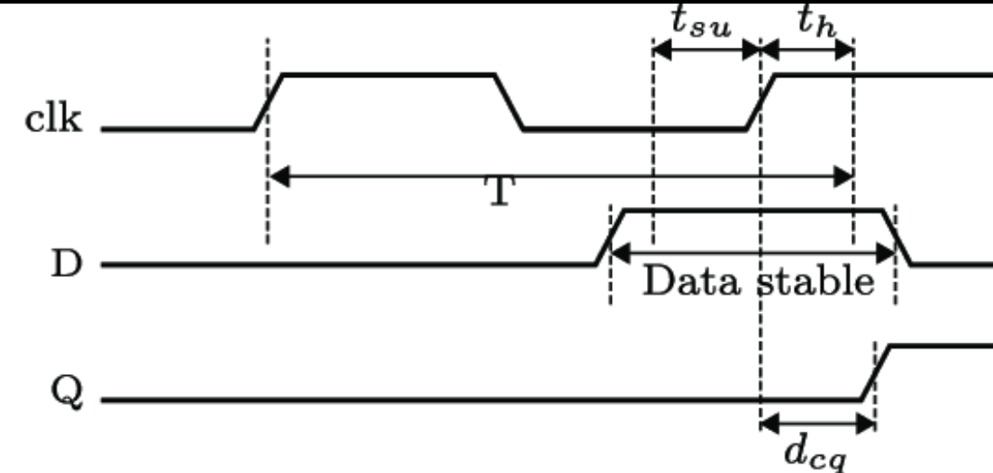
LITERATURE SURVEY
FIFO buffers are widely used in USB transmit paths to handle data rate mismatches and ensure continuous data flow.
Studies show that timing violations in FIFO registers can cause metastability and unreliable data transfer.
Setup time, hold time, and clock-to-Q delay are identified as critical timing parameters in FIFO-based designs.
Existing research mainly focuses on RTL-level FIFO design, while transistor-level timing analysis is limited.
Literature emphasizes the need for circuit-level timing optimization to improve FIFO reliability and performance.

Slide 5
Timing Optimization(Before and Expected Outcomes)
Timing Optimization & Results
Setup Time
Before optimization: 220 ps
After optimization: 120 ps
Hold Time
Before optimization: 15 ps
After optimization: 35 ps
Clock-to-Q Delay
Before optimization: 310 ps
After optimization: 210 ps
Register-to-Register Delay
Before optimization: 240 ps
After optimization: 160 ps
Optimization Techniques Applied
Increased transistor widths in critical D flip-flop paths
Reduced output load capacitance
Inserted buffer at high-load FIFO nodes
Result
Improved timing margins
Stable and reliable USB TX FIFO operation

Slide 6
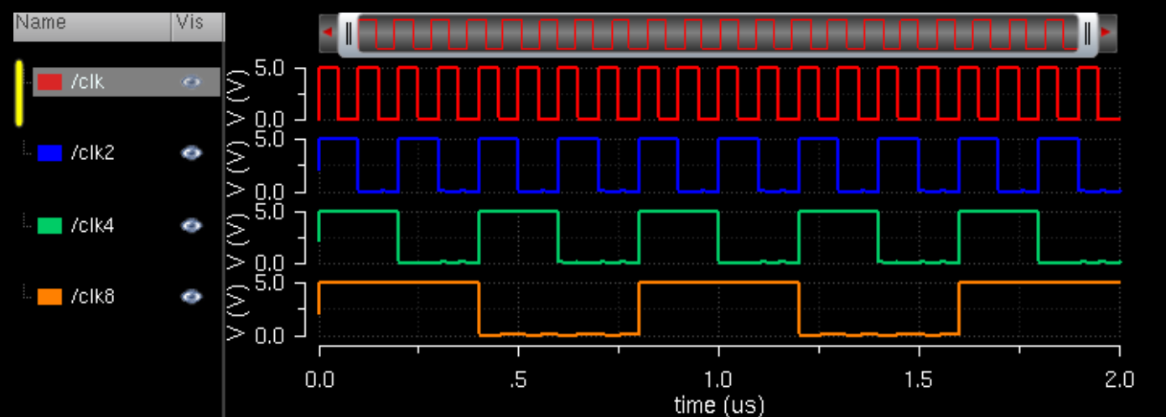
EXPECTED OUTCOMES
Successful transistor-level implementation of USB TX FIFO in Cadence Virtuoso.
Accurate measurement of timing parameters such as setup time, hold time, and clock-to-Q delay.
Identification of critical timing paths within FIFO stages.
Demonstration of timing violations and their correction through optimization.
Improved timing margins and reliable FIFO operation for USB transmit buffering.

